Slide 1
City of Light vs The Swinging City
Clustering Neighborhoods of London and Paris using Machine Learning

Slide 2
Introduction
A Tale of Two Cities, a novel written by Charles Dickens was set in London and Paris, which takes place during the French Revolution. These cities were both happening then and now. A lot has changed over the years, and we now take a look at how the cities have grown.
London and Paris are quite a popular tourist and vacation destinations for people all around the world. They are diverse and multicultural and offer a wide variety of experiences that are widely sought after. We try to group the neighborhoods of London and Paris respectively and draw insights to what they look like now.

Slide 3
Business Problem
The aim is to help tourists choose their destinations depending on the experiences that the neighborhoods have to offer and what they would want to have. This model also helps people make decisions if they are thinking about migrating to London or Paris or even if they wish to relocate neighborhoods within the city. Our findings will help stakeholders make informed decisions and address any concerns they have, including the different kinds of cuisines, provision stores and what the city has to offer.

Slide 4
Data Description
We require geographical location data for both London and Paris. Postal codes in each city serve as a starting point. Using Postal codes, we can find out the neighbourhoods, boroughs, venues and their most popular venue categories.

Slide 5
Foursquare API Data
We will need data about different venues in different neighborhoods of that specific borough. To gain that information, we will use “Foursquare” location information. Foursquare is a location data provider with information about all manner of venues and events within an area of interest. Such information includes venue names, locations, menus and even photos. As such, the foursquare location platform will be used as the sole data source since all the stated required information can be obtained through the API.
After finding the list of neighborhoods, we then connect to the Foursquare API to gather information about venues inside each neighborhood. For each neighborhood, we have chosen the radius to be 500 meters.

Slide 6
Foursquare API Data
The data retrieved from Foursquare contained information of venues within a specified distance of the longitude and latitude of the postcodes. The information obtained per venue as follows:
Neighborhood: Name of the Neighborhood
Neighborhood Latitude: Latitude of the Neighborhood
Neighborhood Longitude: Longitude of the Neighborhood
Venue: Name of the Venue
Venue Latitude: Latitude of Venue
Venue Longitude: Longitude of Venue
Venue Category: Category of Venue

Slide 7
Foursquare API Data
Based on all the information collected for both London and Paris, we have sufficient data to build our model. We cluster the neighbourhoods together based on similar venue categories. We then present our observations and findings. Using this data, our stakeholders can take the necessary decision.

Slide 8
Data Collection
In the data collection stage, we begin with collecting the required data for the cities of London and Paris. We need data that has the postal codes, neighborhoods and boroughs specific to each of the cities.
To collect data for London, using pandas, we scrape the List of areas of London Wikipedia page to take the 2nd table:
nom_comm: Name of Neighborhoods in France
nom_dept: Name of the boroughs, equivalent to towns in France
geo_point_2d: Tuple containing the latitude and longitude of the Neighborhoods.

Slide 9
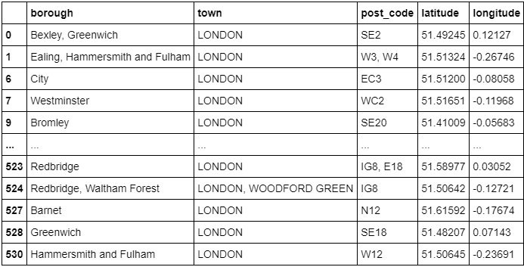
Feature Selection
For both of our datasets, we need only the borough, neighborhood, postal codes and geolocations (latitude and longitude). So we end up selecting the columns that we need by

Slide 10
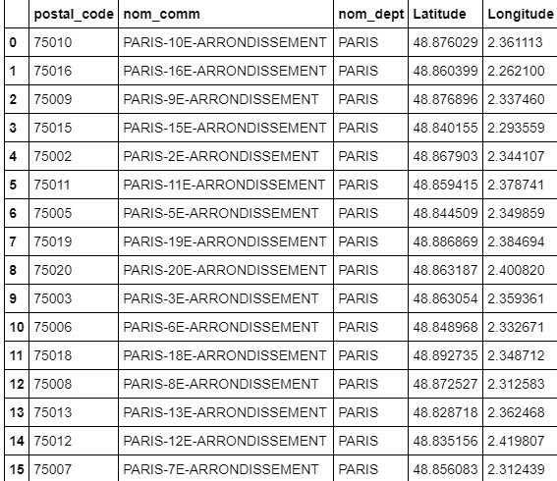
Feature Engineering
Both of our Datasets contain information related to all the cities in the country. We can narrow down and further process the data by selecting only the neighbourhoods of ‘London’ and ‘Paris’.
We then create our Paris dataset with the required information:

Slide 11
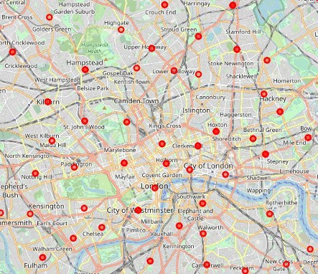
Visualizing the Neighborhoods of London and Paris
Now that our datasets are ready, using the Folium package, we can visualize the maps of London and Paris with the neighborhoods that we collected.
Map of London showing the neighborhoods

Slide 12
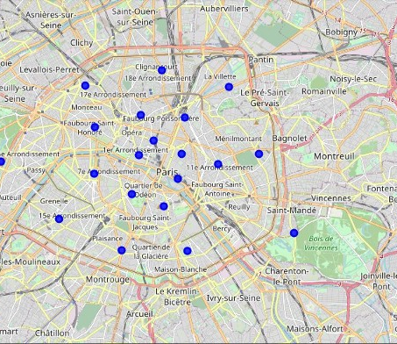
Visualizing the Neighborhoods of London and Paris
Map of Paris showing the neighborhoods
Now that we have visualized the neighborhoods, we need to find out what each neighborhood is like and what are the common venue and venue categories within a 500 m radius.

Slide 13
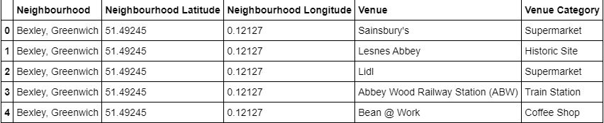
Data collected using Foursquare API

Slide 14
Examining our Clusters
We could examine our clusters by expanding on our code using the Cluster Labels column
Cluster 1
london_data_nonan.loc[london_data_nonan['Cluster Labels'] == 1, london_data_nonan.columns[[1] + list(range(5, london_data_nonan.shape[1]))]]
Cluster 2
london_data_nonan.loc[london_data_nonan['Cluster Labels'] == 2, london_data_nonan.columns[[1] + list(range(5, london_data_nonan.shape[1]))]]
Cluster 3
london_data_nonan.loc[london_data_nonan['Cluster Labels'] == 3, london_data_nonan.columns[[1] + list(range(5, london_data_nonan.shape[1]))]]

Slide 15
Examining our Clusters
Cluster 4
london_data_nonan.loc[london_data_nonan['Cluster Labels'] == 4, london_data_nonan.columns[[1] + list(range(5, london_data_nonan.shape[1]))]]
Cluster 5
london_data_nonan.loc[london_data_nonan['Cluster Labels'] == 5, london_data_nonan.columns[[1] + list(range(5, london_data_nonan.shape[1]))]]

Slide 16
Results and Discussion
The neighborhoods of London are very multicultural. There are a lot of different cuisines including Indian, Italian, Turkish and Chinese. London seems to take a step further in this direction by having a lot of restaurants, bars, juice bars, coffee shops, Fish and Chips shop and Breakfast spots. It has a lot of shopping options too with that of the Flea markets, flower shops, fish markets, Fishing stores, clothing stores. The main modes of transport seem to be Buses and trains. For leisure, the neighbourhoods are set up to have lots of parks, golf courses, zoo, gyms and Historic sites. Overall, the city of London offers a multicultural, diverse and certainly entertaining experience.

Slide 17
Results and Discussion
Paris is relatively small in size geographically. It has a wide variety of cuisines and eateries including French, Thai, Cambodian, Asian, Chinese etc. There are a lot of hangout spots including many Restaurants and Bars. Paris has a lot of Bistros. Different means of public transport in Paris which includes buses, bikes, boats or ferries. For leisure and sightseeing, there are a lot of Plazas, Trails, Parks, Historic sites, clothing shops, Art galleries and Museums. Overall, Paris seems like the relaxing vacation spot with a mix of lakes, historic spots and a wide variety of cuisines to try out.

Slide 18
Conclusion
The purpose of this project was to explore the cities of London and Paris and see how attractive it is to potential tourists and migrants. We explored both the cities based on their postal codes and then extrapolated the common venues present in each of the neighbourhoods finally concluding with clustering similar neighbourhoods together.
We could see that each of the neighbourhoods in both the cities have a wide variety of experiences to offer which is unique in its own way. The cultural diversity is quite evident which also gives the feeling of a sense of inclusion.

Slide 19
Conclusion
Both Paris and London seem to offer a vacation stay or a romantic getaway with a lot of places to explore, beautiful landscapes, amazing food and a wide variety of culture. Overall, it’s up-to-the stakeholders to decide which experience they would prefer more and which would more to their liking.

Slide 20
References
The Battle of Neighbourhood — My London’s Perspective by Dayo John
The Battle of neighborhoods! What is the best place where can I start my restaurant business in Paris? by Zakaria BOUZIANE
3.A Tale of Two cities blog by Thomas george

